Slide 1

The Russian doll
By Kylian, Alexandre, Bernd and Evi

Slide 2
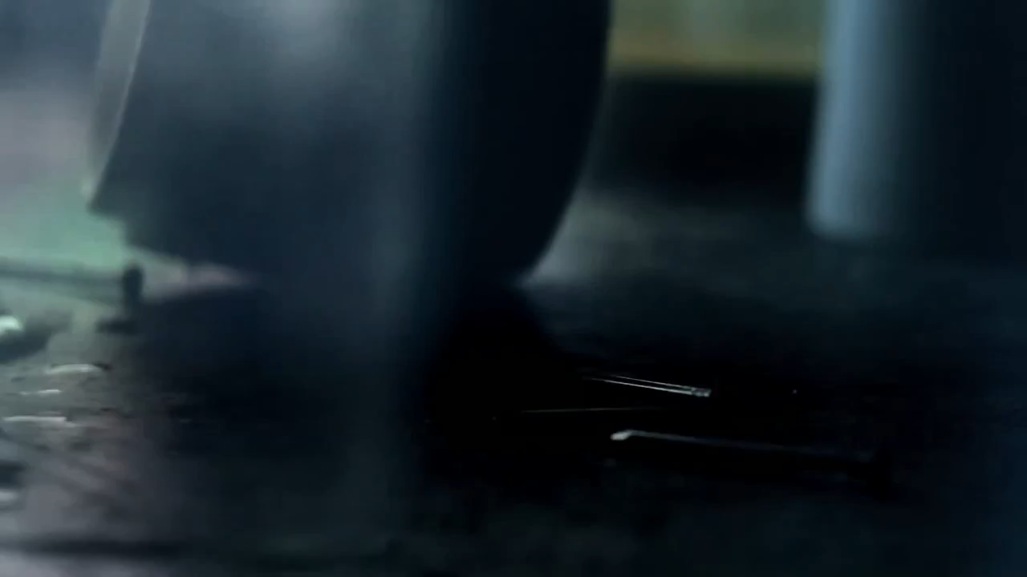

Slide 3

Where?
France
06/2010

Slide 4



The subjects
Murder
False imprisonment
No freedom of press
Abuse

Slide 5
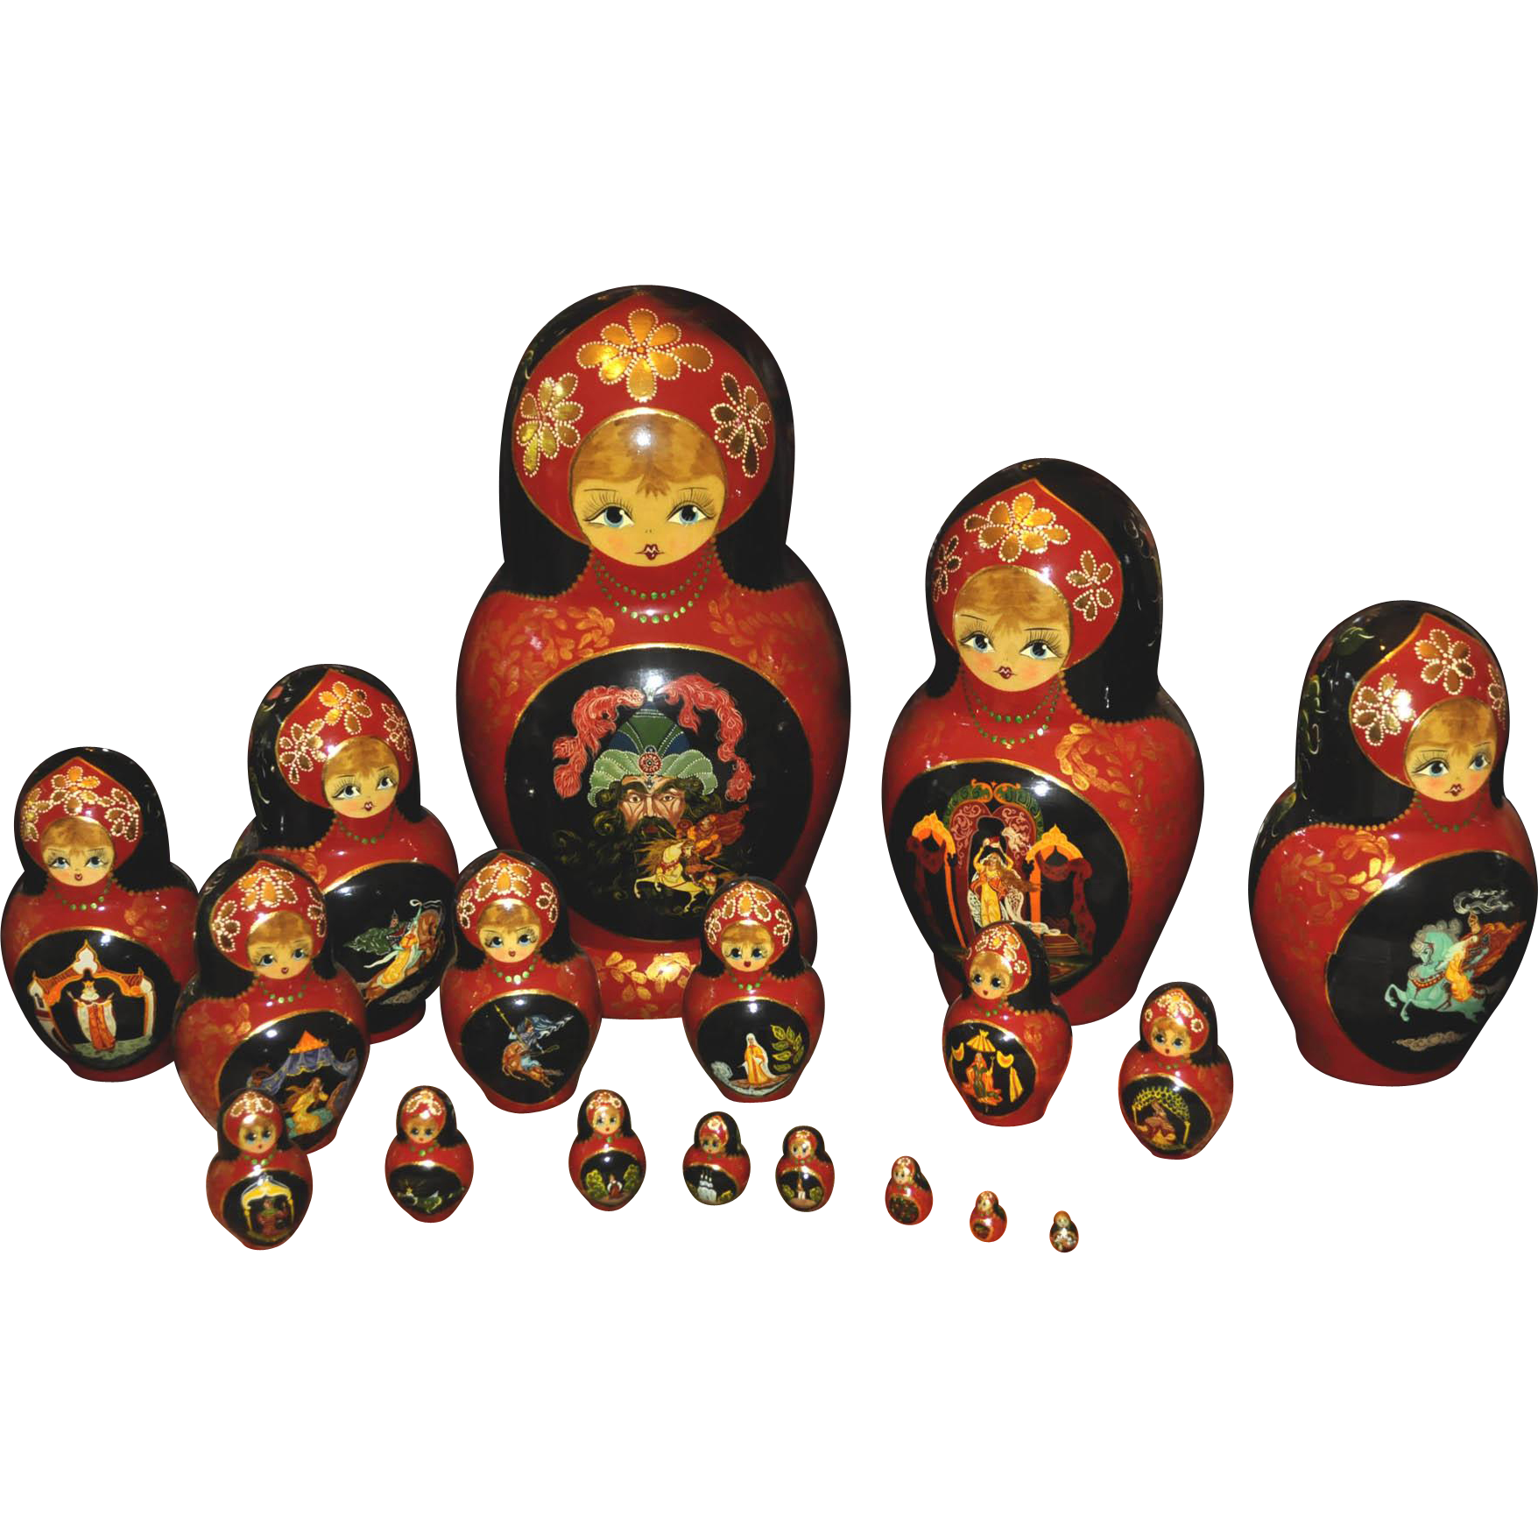
With what?
Russian dolls

Slide 6

The message
Russia
Atrocities are being kept silent
“masked with a smile”

Slide 7
"We must not let Russia's charm hide its atrocities"

